Slide 1
Unit 11 Chapter 15
MONOPOLY
Concept of market power and price making
Why monopolies arise?
Monopoly in resources
Government regulated monopolies
Natural monopolies

Slide 2
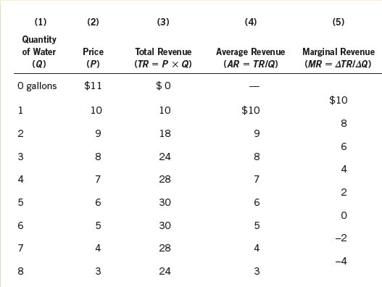
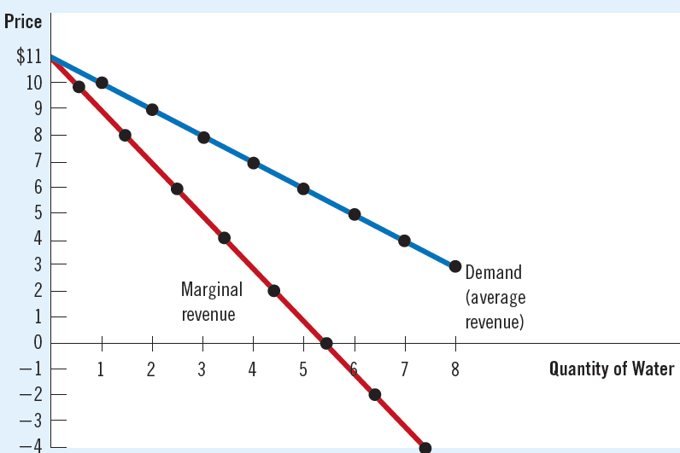
How monopolies make production and pricing decisions?
Demand curve of a monopolist and a competitive firm
Downward sloping curve
Monopolist can get a higher price only if it limits Q
Revenue of the monopolist
As supply increases, price falls
AR = P, but MR is lower
To sell more quantity, lower price
Widening gap between P and MR
Output effect and price effect

Slide 3
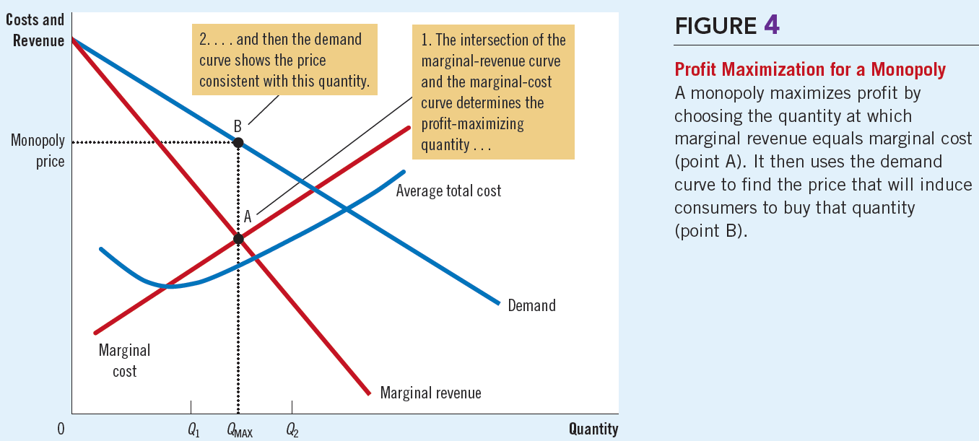
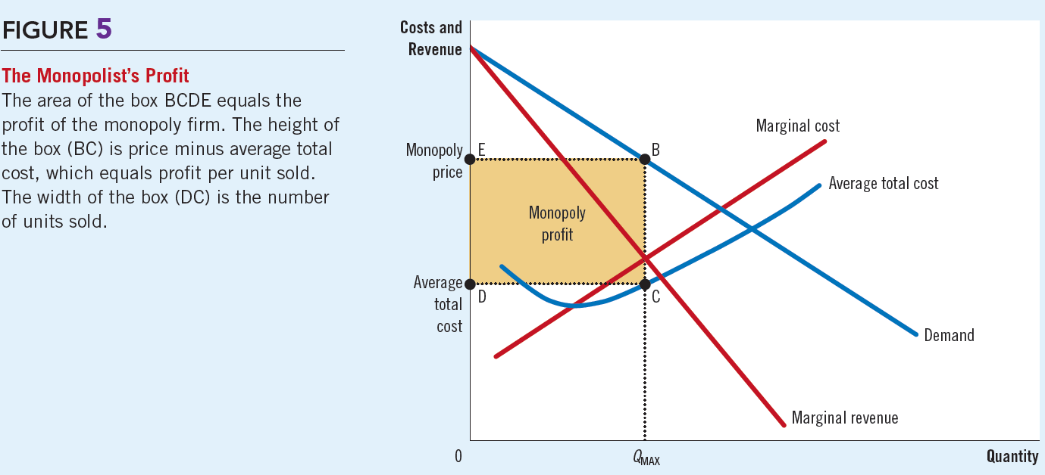
How monopolies make production and pricing decisions?
Profit maximization in monopoly
Quantity obtained at MR = MC
Price obtained at AR curve
At Q1 and Q2, MR is not equal to MR
P > MR = MC
Profit in a monopoly
[P-AC] x Q as the basic condition
Qmax identifies the AC for monopolist
The gap between P-AC; profit per unit
Multiplied by the quantity gives the profit
Above normal profit

Slide 4
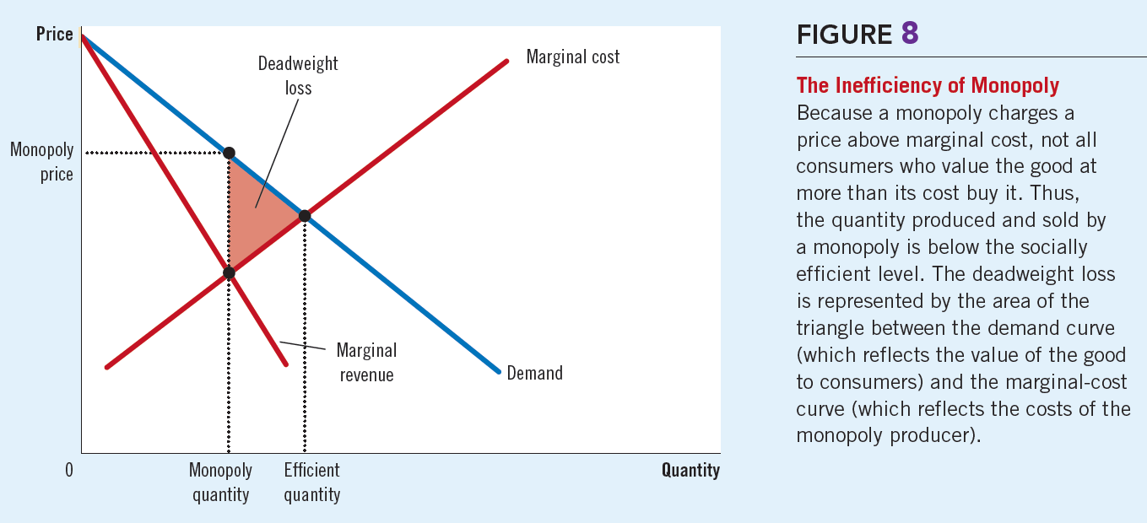
Welfare cost of monopolies
Competitive welfare v/s monopoly
Socially efficient quantity obtained at D = S
TS= buyer’s value – producer cost
Monopoly quantity is obtained is MR = MC; P> MR
Deadweight loss in monopoly
Inefficient quantity at price > MR
Not everyone who values the good more than the price gets it
Inefficient quantity results in deadweight loss
Social cost of monopoly profit?
TS in monopoly may be equal to competitive markets
Source of high surplus is producer’s profit
Inefficiency arises from the production of less than efficient quantity

Slide 5
Price discrimination
The business practice of selling the same good at different prices to different customers
Dynamic prices of hotels, airline travel etc.
Firm should have the market power in order to discriminate
Rational strategy for a monopolist as it increases profit
Differential treatment to customers according to their willingness to pay (assuming perfect price discrimination)
Can increase overall welfare

Slide 6
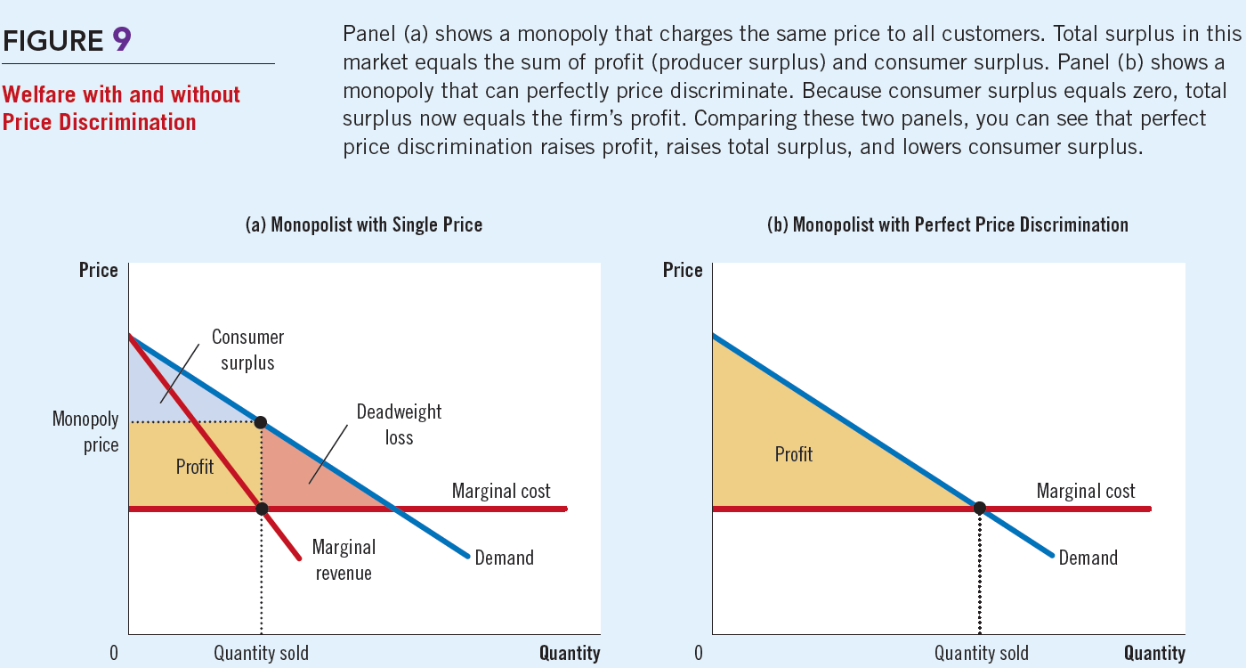
Price discrimination

Slide 7
Price discrimination

